Slide 1
Red, Green, Deploy:
Why Security Testing Matters
Galen Emery
Customer Architect - Federal
@galen_emery

Slide 2

Who's this guy?
Galen Emery (@galen_emery)
Customer Architect at Chef
Formerly Solutions Architect (Federal) at Chef
Former Windows Sysadmin
Live in San Diego, CA

Slide 3


Slide 4
Good Practice Constraints

Slide 5
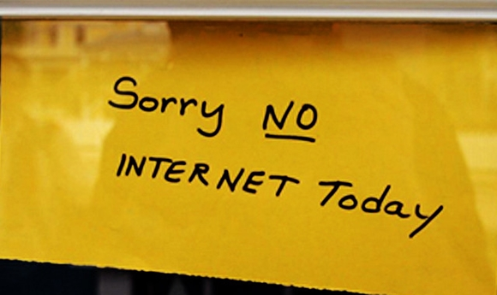
Assume you don’t have internet
Even if you do
Build this into your pipeline
Test this on the low side
Your systems should NOT assume internet access
Most tooling by default assumes it does

Slide 6

Security won’t let me!
Work with them. They are a vital component of your business (or should be)
Identify where the risk is. The risk is with the data, not with the user.
Consume Risk in Dev, not in Prod (Fail Fast)
Progress is coming

Slide 7
This is a true story...
Auditor: "Communication from your network devices to your authentication server must be encrypted."

Slide 8
This is a true story...
Auditor: "Communication from your network devices to your authentication server must be encrypted."
Colleague: "We use BlahBlah TACACS+ server. You can't disable encryption."

Slide 9
This is a true story...
Auditor: "Okay. Please show me that encryption is enabled in your configuration."

Slide 10
This is a true story...
Auditor: "Okay. Please show me that encryption is enabled in your configuration."
Colleague: "Um… I can't. I can't disable it, so I can't show you where it's enabled. But I can show you that I'm using BlahBlah TACACS+ server."

Slide 11
This is a true story...
Auditor: "Can you show me how you can't disable it?"

Slide 12

This is a true story...
Auditor: "Can you show me how you can't disable it?"
Collleague:

Slide 13
This is a true story...
Colleague: "How about I show you where I configured the encryption key? Is that good enough?"

Slide 14
This is a true story...
Colleague: "How about I show you where I configured the encryption key? Is that good enough?"
Auditor: "Ummmm… sure."

Slide 15
Why did I tell you this?
How to prove "compliance" might not be obvious
What the auditor was looking for can be automated
This happened multiple times a year
We really need to automate

Slide 16
OMG so much compliance
PCI-DSS
Dodd-Frank
HITECH
ISO
HIPAA
Grundschutz
Sarbanes-Oxley
General Data Protection Regulation (GDPR)
Gramm-Leach-Bliley Act
DISA STIG
NIST
CVE

Slide 17
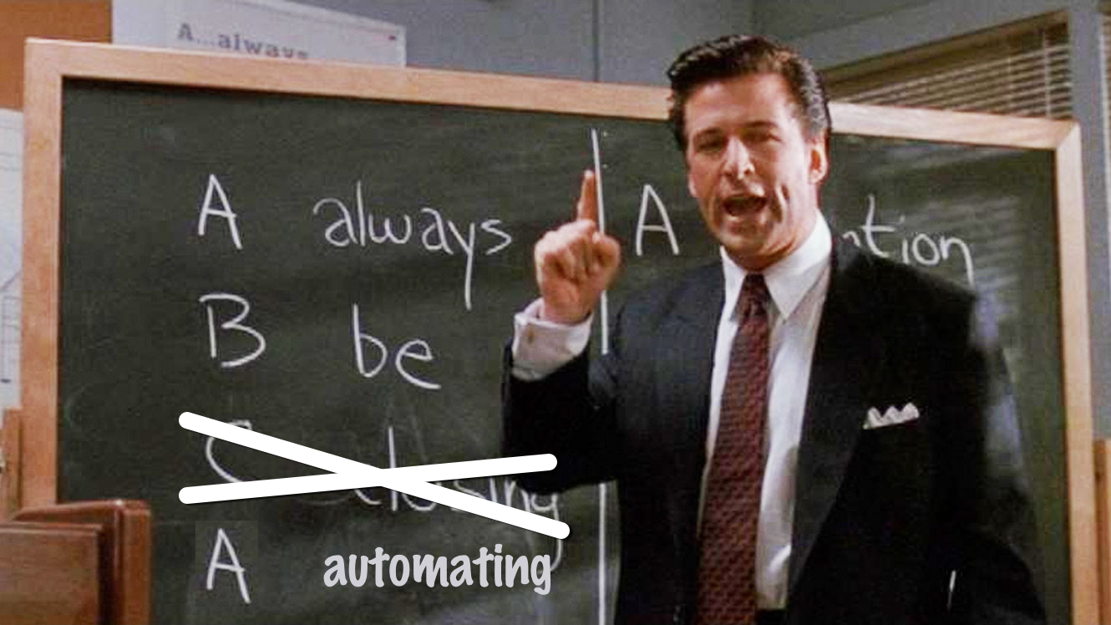

Slide 18

ABA: Always Be Automating

Slide 19
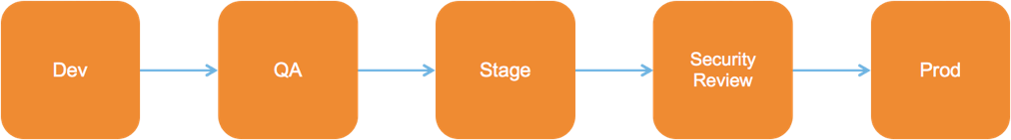
Compliance: the everlasting roadblock...

Slide 20
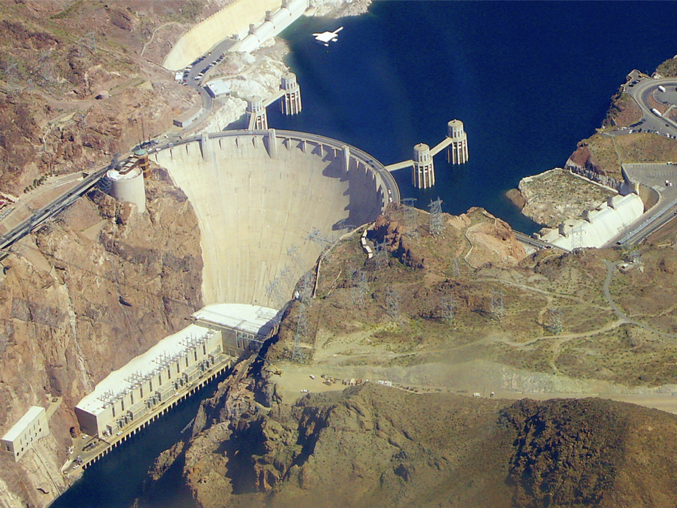
Product Ideas and Features
Security Review
Production

Slide 21
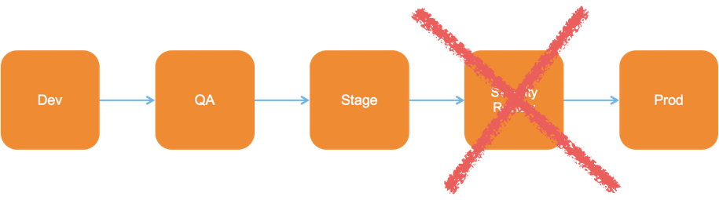
Compliance: the everlasting roadblock...

Slide 22
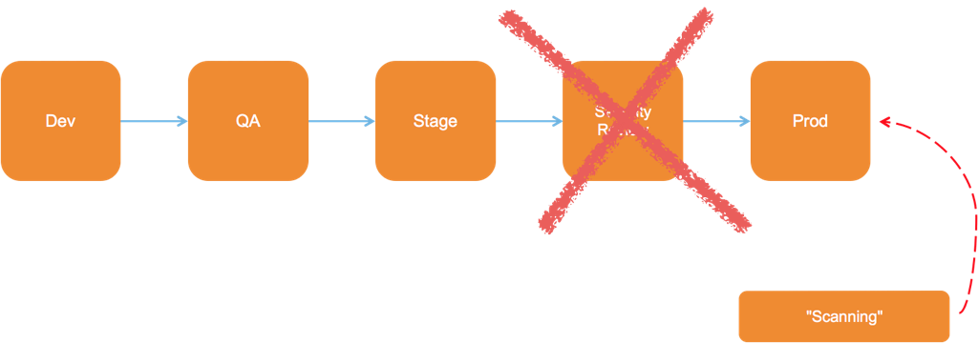
Compliance: the everlasting roadblock...

Slide 23
The OODA Loop
Observe
Act
Orient
Decide

Slide 24
OODA: Observe
How do you know when it's time for a new compliance control?
Who is responsible?

Slide 25


Slide 26
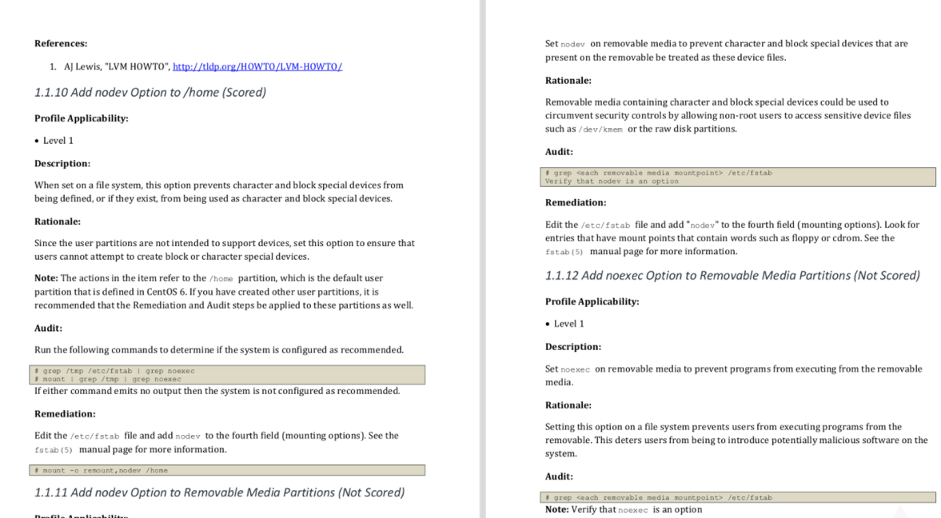

Slide 27
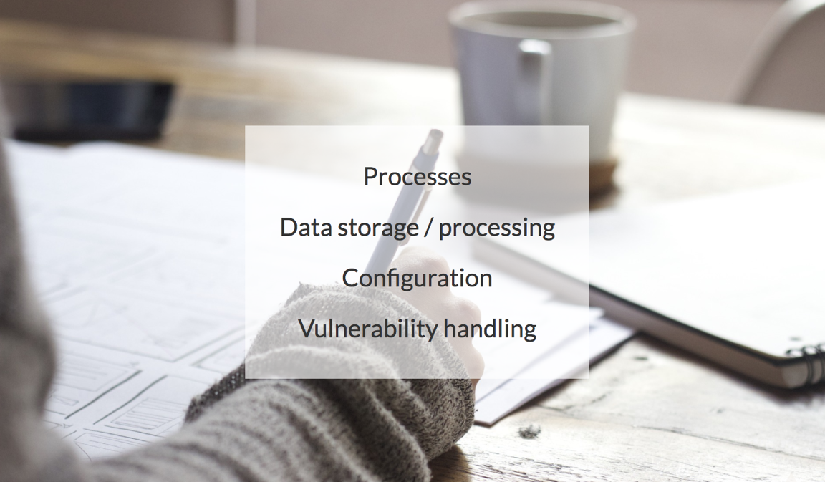

Slide 28
An Example from Documentation
404.3.5: Communication between network devices and central authentication systems must be encrypted at all times.

Slide 29
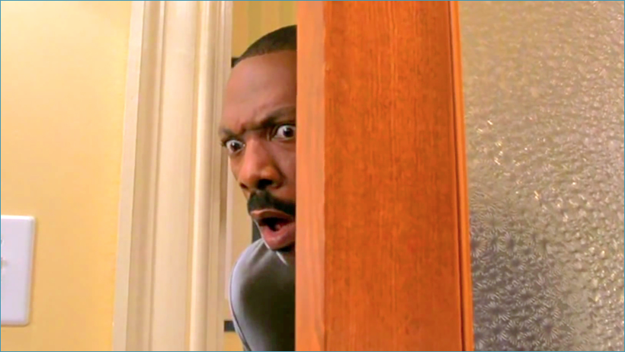
OODA: Orient

Slide 30
I can totally script that...
$ grep "^key" /etc/tac_plus/tac_plus.conf | sed 's/key = //'
s00persecretkey
$

Slide 31

...but there's no context.

Slide 32


Slide 33
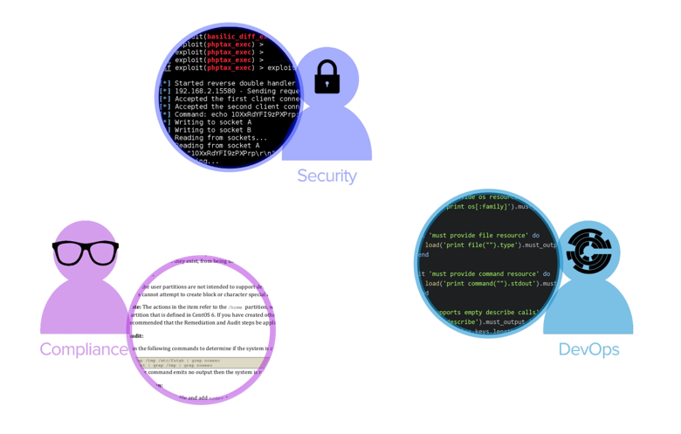
A tale of three personas...

Slide 34
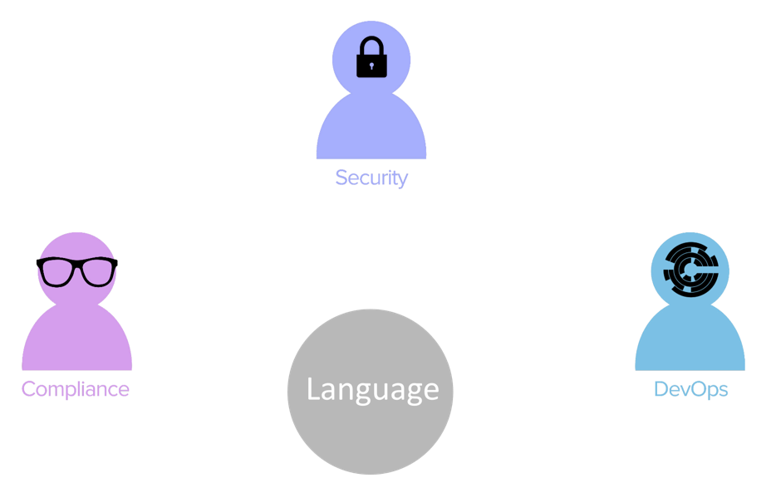
… and a single language.

Slide 35
From lemons...
$ grep "^key" /etc/tac_plus/tac_plus.conf | sed 's/key = //'
s00persecretkey
$

Slide 36
… create lemonade!
control 'sox-404.3.5' do
title 'Network Device to Central Auth Encryption'
impact 1.0
desc "
All communication between network devices and central auth
must be encrypted. Our TACACS+ servers encrypt all the time
and the presence of a pre-shared key proves it."
describe ini('/etc/tac_plus/tac_plus.conf') do
its('key') { should_not be_nil }
end
end

Slide 37
Map Documentation to Controls
control 'sox-404.3.5' do
title 'Network Device to Central Auth Encryption'
impact 1.0
desc "
All communication between network devices and
central auth must be encrypted. Our TACACS+ servers
encrypt all the time and the presence of a
pre-shared key proves it."
describe ini('/etc/tac_plus/tac_plus.conf') do
its('key') { should_not be_nil }
end
end
404.3.5: Communication between network devices and central authentication systems must be encrypted at all times.

Slide 38
Share Context
control 'sox-404.3.5' do
title 'Network Device to Central Auth Encryption'
impact 1.0
desc "
All communication between network devices and
central auth must be encrypted. Our TACACS+ servers
encrypt all the time and the presence of a
pre-shared key proves it."
describe ini('/etc/tac_plus/tac_plus.conf') do
its('key') { should_not be_nil }
end
end
404.3.5: Communication between network devices and central authentication systems must be encrypted at all times.

Slide 39
Automate Test Execution
control 'sox-404.3.5' do
title 'Network Device to Central Auth Encryption'
impact 1.0
desc "
All communication between network devices and
central auth must be encrypted. Our TACACS+ servers
encrypt all the time and the presence of a
pre-shared key proves it."
describe ini('/etc/tac_plus/tac_plus.conf') do
its('key') { should_not be_nil }
end
end
404.3.5: Communication between network devices and central authentication systems must be encrypted at all times.

Slide 40
One Language
Linux
Windows
BSD
Solaris
AIX
… and more

Slide 41
Yup, I said Windows...
control 'windows-base-201' do
impact 1.0
title 'Strong Windows NTLMv2 Authentication Enabled'
desc 'http://support.microsoft.com/en-us/kb/823659'
describe registry_key('HKLM\System\CurrentControlSet\Control\Lsa') do
it { should exist }
its('LmCompatibilityLevel') { should cmp 4 }
end
end

Slide 42
One Language
Bare Metal
VMs
Containers

Slide 43

Test Locally
$ inspec exec /path/to/profile

Slide 44

Test Remotely
$ inspec exec /path/to/profile -i ssh.key -t ssh://me@myhost

Slide 45

Test Remotely
$ inspec exec /path/to/profile -t winrm://me@myhost --password secret

Slide 46
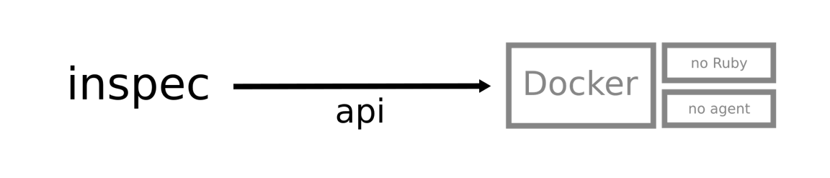
Test Remotely
$ inspec exec /path/to/profile -t docker://3cc8837bb6a8

Slide 47
Test via Chef Client Runs
Chef
Client
Chef
Server
Chef
Automate
InSpec via
"audit" cookbook

Slide 48
Test via Test Kitchen
verifier:
name: inspec
inspec_tests:
- name: company-base
compliance: company/base-profile
- name: app1
compliance: company/app1-profile

Slide 49



Compliance at every step

Slide 50
OODA: Decide
How urgent is this?
Where does this fall in our backlog?
How do we become compliant?

Slide 51
Assessing Impact and Priority
control 'sox-404.3.5' do
title 'Network Device to Central Auth Encryption'
impact 1.0
desc "
All communication between network devices and
central auth must be encrypted. Our TACACS+ servers
encrypt all the time and the presence of a
pre-shared key proves it."
describe ini('/etc/tac_plus/tac_plus.conf') do
its('key') { should_not be_nil }
end
end
404.3.5: Communication between network devices and central authentication systems must be encrypted at all times.

Slide 52
Assessing Impact and Priority
control 'no-telnet' do
title 'telnet not installed'
impact 0.5
tag 'pci'
ref 'pci stage 1', url: 'https://wiki.mycompany.biz/…'
desc "
PCI-DSS requires all admin traffic to be encrypted. Telnet
is not encrypted and is therefore not permitted."
describe package('telnetd') do
it { should_not be_installed }
end
end

Slide 53
OODA: Act
What does remediation look like?
Can I test my remediation steps?

Slide 54
Compliance at every step

Slide 55
The OODA Loop
Observe
Act
Orient
Decide

Slide 56
The OODA Loop
Observe
Act
Orient
Decide

Slide 57
Why InSpec?
Break down silos between organizations
Codify your compliance agreements and requirements
Share context about your compliance requirements
Achieve safety at velocity with compliance at every step

Slide 58
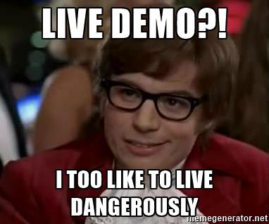

Slide 59

Consistency

Slide 60
An Example from Documentation
NIST 800-53 AC-17(6):
REMOTE ACCESS | PROTECTION OF INFORMATION The organization ensures that users protect information about remote access mechanisms from unauthorized use and disclosure.

Slide 61
Acknowledgments:
Adam Leff (@adamleff)
Have travel troubles? Blame him with #thanksadamleff on twitter
Dominik Richter & Christoph Hartmann (Founders of Inspec)

